Slide 1
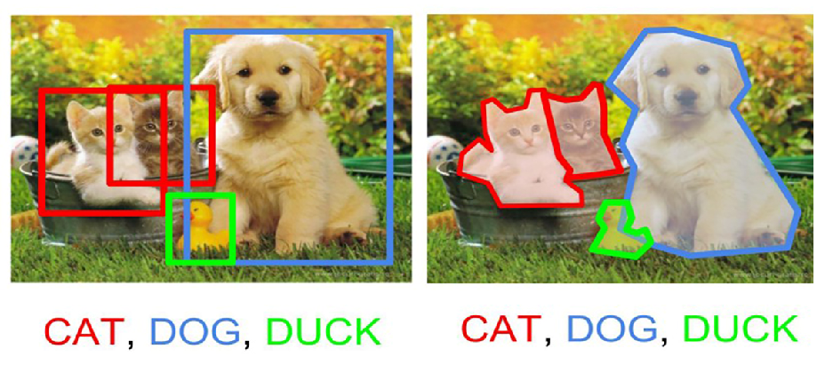
Object Detection
Aayush Sisodia,
Aswani Gollakota,
Jayashree Ganesh Kumar,
Puja Doshi,
Saranya Jeevanandam,
Stephen Holsenbeck
Team 6
Manali Sharma, Aswani Gollakota

Slide 2
Project Outline and Goal
Object detection is a computer technology related to computer vision and image processing that deals with detecting instances of semantic objects of a certain class (such as humans, buildings, or cars) in digital images.
Goal:
This project is an attempt at developing an object detection model using modern computer vision technology. The project aims to incorporate state-of-the-art techniques for object detection with the goal of achieving high accuracy in detecting objects.
Input:
ImageNet dataset
Output:
Identified Objects (Persian cat, Mountain bike, Lizard, Turtle etc.) maximum 4 objects will be detected in given
Image
Reference:
https://www.kaggle.com/c/imagenet-object-localization-challenge/data

Slide 3
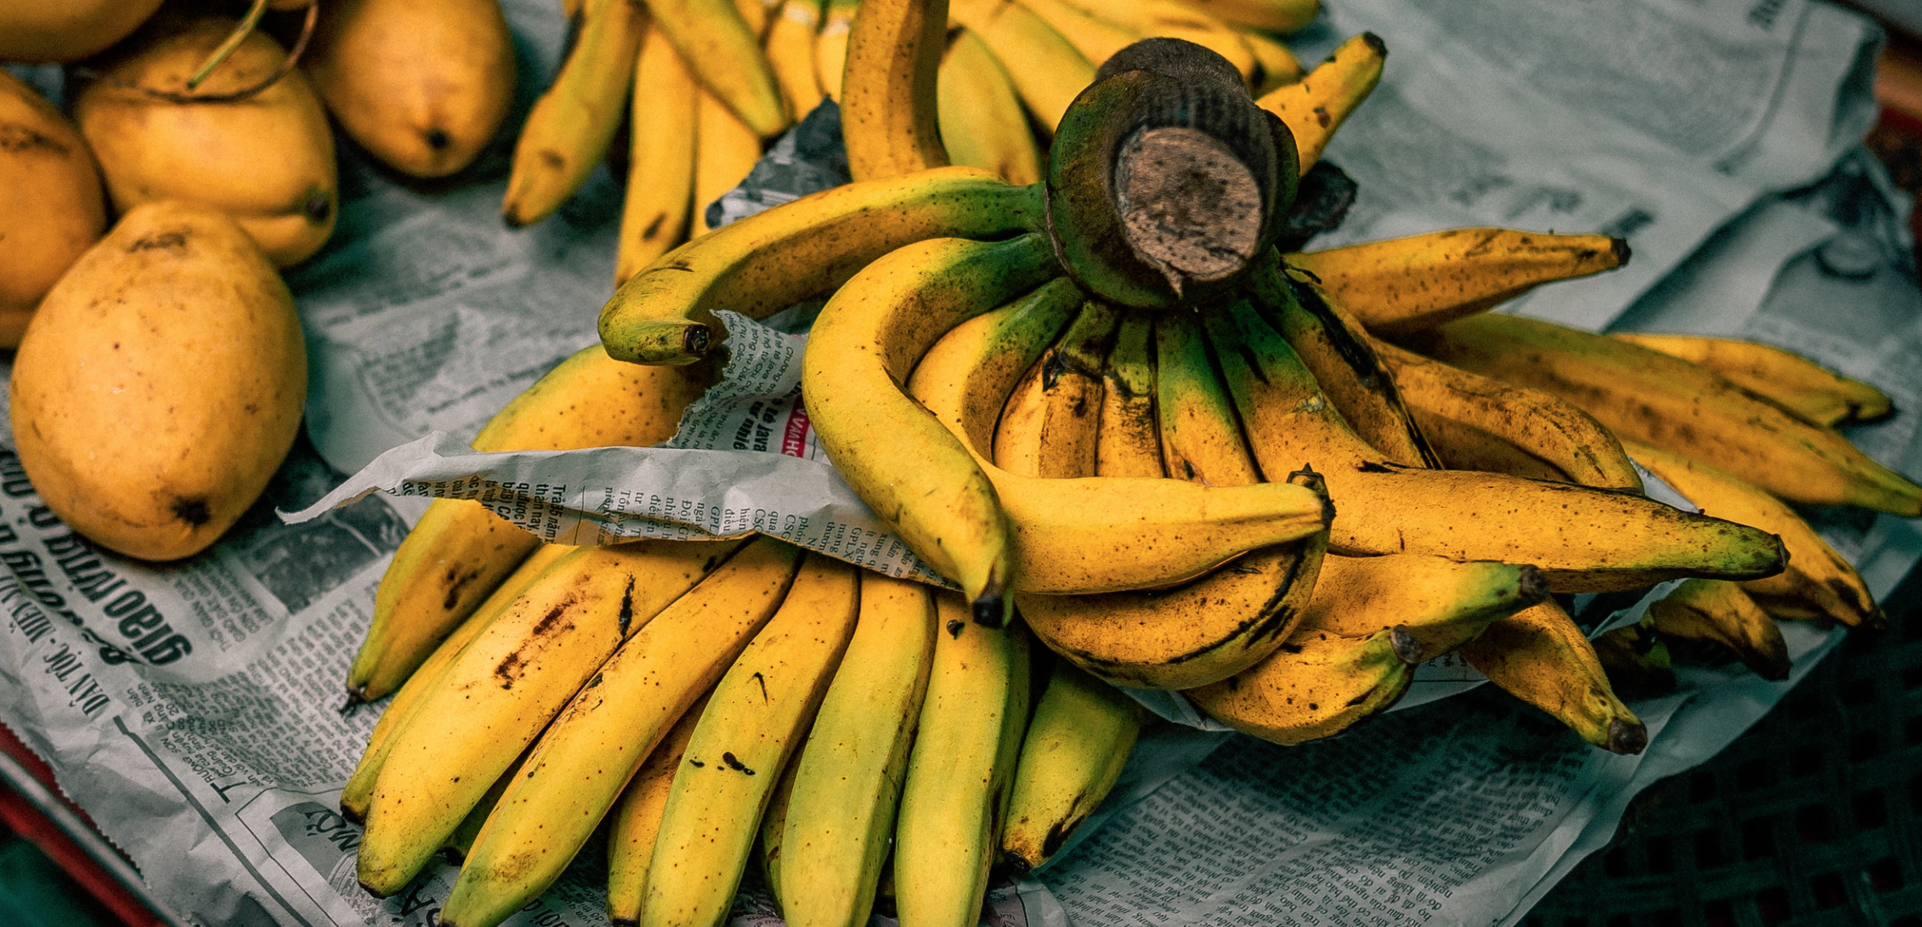
Data source & Use case
Data source:
ImageNet dataset
Labels:
Image wnid(1000) along with images. Wnid and the object name is saved in text file.
e.g. n02119022 red fox, Vulpes vulpes
Use case:
Input: ILSVRC2012_val_00048981.jpeg
Output: n07753592 n07753113
(in this case this image has 2 objects)
Training dataset:
544546
Validation Dataset:
50000
Overall size:
154GB
Tools & Technology:
Scala with spark, S3 or HDFS (probable database)

Slide 4
Design and Methodology
Prepare the training data (collect, pre-process, vectorise etc.)
Divide the data into training set/cross-validation set/test set for evaluation.
Create the neural network architecture.
Define the types, number and size of layers.
Define other hyper parameters such as loss function, optimizer, or learning rate.
Train your model on the training data.
Evaluate your model on the cross-validation set. Depending on the results, repeat steps 3-5 with different hyper parameters, or collect more data until you're satisfied with the results.
Do a final evaluation on the test set.

Slide 5
Architecture
Scala libraries considered:
Eclipse Deeplearning4j
ScalNet:
ScalNet is a wrapper around Deeplearning4J emulating a Keras like API for deep learning.
TensorFlow for Scala:
This library is a Scala API for https://www.tensorflow.org
Apache MXNet:
Similar to TensorFlow, MXNet supports creating symbolic computation graphs, decoupling computation logic from execution. Furthermore, it provides support for eager execution as well for a more imperative approach.
Infrastructure/Cluster:
Google cloud or AWS S3 bucket
Notes:
The arrows show how the inputs of a neuron from one layer are connected to the outputs from the previous layer. As you can see in the image, each input is connected to all the outputs of the previous layer, which is why this type of layer is called a fully connected layer. Each neuron has a number of weights or parameters, one for each input, whose values are determined during training. As we've seen in part one, these weights contain the memory of a neural network, and represent what the network has learned. In our case, how it maps the input image to the a digit. The input layer just represents the input values and does not have any weights, nor does it do any computation. In our MNIST example the input is the raw pixels of the image, normalized to have a range between zero and one. So we have 28 * 28 input values, represented as a vector of 784 float values. During a forward pass through the network, each input of a neuron is multiplied by its corresponding weight , and the results of that multiplication are summed up. In our hidden layer, the resulting value is then fed into an activation function called relu that just passes through all positive values but sets any negative number to zero.In the output layer, we use a softmax function instead, which returns a probability score for each of the 10 classes representing digits. The digit with the highest probability is what the network predicts as image content.

Slide 6
Why scala with spark
Scala has as set of features that make it particularly well suited for building neural networks. Its functional nature and expressiveness is ideal for elegant composition of tensor operations and neural network architecture.
Scala's syntax and its type inference enables expressing tensor operations in a concise and readable way. At the same time, its powerful static type system can help catching certain kinds of errors early on at compile time, adding safety and often making development and especially maintenance more productive. Scala is oftentimes fun to program in.
Spark:
Spark MLlib is more suitable for big data deep learning that store data across a cluster of nodes. Spark is able to run programs over faster when running on disk. Spark has a complex DAG or Directed Acrylic Graph) execution engine that provides support for cyclic data flow and in-memory data sharing across DAGs to carry out different jobs with the same data.
So scala with spark will be better combination to use for the current project, given the size of the data and the complexity of the algorithm.

Slide 7
Repository and Application criteria
Repository: Github
Programming:
As most of the programming is done by us we will use some sample code from below references.
https://brunk.io/deep-learning-in-scala-part-3-object-detection.html
https://becominghuman.ai/an-introduction-to-the-mxnet-api-part-1-848febdcf8ab
https://github.com/Esperanzora/ANRecognitionSystem
Acceptance Criteria:
Mean Average Precision, as described below, is particularly used for algorithms where we are predicting the location of the object along with the classes.
Challenges and Limitations:
Due to the dataset size model training will be performed on less number of images depending the cluster requirements.

Slide 8
Milestones
Nov 17
Data extraction, cleaning and storing
Nov 17
Data extraction, cleaning and storing
Nov 29
Model implementation on testing data set.
Nov 29
Model implementation on testing data set.
Nov 13
Repository setup,
Big data source setup
Nov 13
Repository setup,
Big data source setup
Nov 13
Repository setup,
Big data source setup
Nov 22
Training dataset and validation dataset processing. Algorithm design
Nov 22
Training dataset and validation dataset processing. Algorithm design
Nov 24
Object detection algorithm development
Nov 24
Object detection algorithm development
Dec 5
Result and evaluation
Dec 5
Result and evaluation
Image processing
Image processing
Image processing
Object detection
Nov 20
Images summary and analysis
Nov 20
Images summary and analysis
Nov 27
Model development using training data set.
Nov 27
Model development using training data set.
Matching & evaluation
Matching & evaluation

Slide 9
Thank You!

